Slide 1

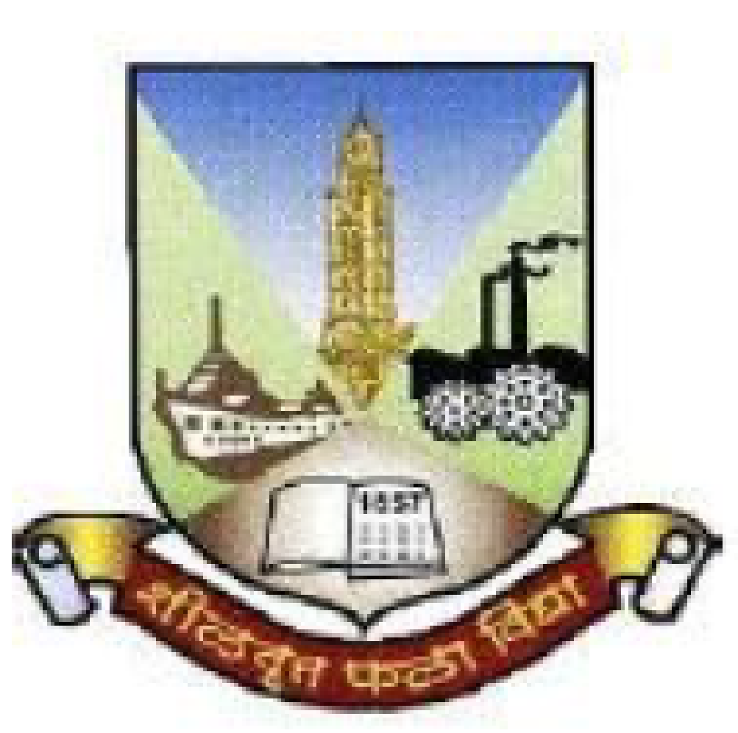
IPMV Project Review (Semester VI)
Vivekanand Education Society's Institute of Technology
An Autonomous Institute Affiliated to University of Mumbai
Recreation of Zoopraxiscope and Bitmap Raster image in today's environment with modified method but no shortcuts.
Group No: 7
Bhakti Daga (D14B/14)
Nirmiti Mongane (D14B/34)
Parul Pritamwani (D14B/43)
Sanika Pawar (D14B/49)

Slide 2
Contents to be covered
Problem Statement
Proposed Solution
History of Zoopraxiscope
History of Bitmap Raster Image
Flowchart of Zoopraxiscope
Flowchart of Bitmap Raster Image
Implementation of Bitmap Raster Image
Components requirement
References

Slide 3
Problem Statement
Our project focuses on modernizing and replicating the Zoopraxiscope, an early motion picture device, along with updating bitmap raster images using contemporary techniques, ensuring a comprehensive approach without shortcuts.

Slide 4
Proposed Solution
Conduct thorough research on the original Zoopraxiscope and bitmap raster images, including their construction, operation, and historical context.
Analyze existing examples and documentation to understand the principles behind their design and functionality.
Use the gathered knowledge to design and prototype the Zoopraxiscope and bitmap raster images and implement them using modern design softwares and other tools

Slide 5
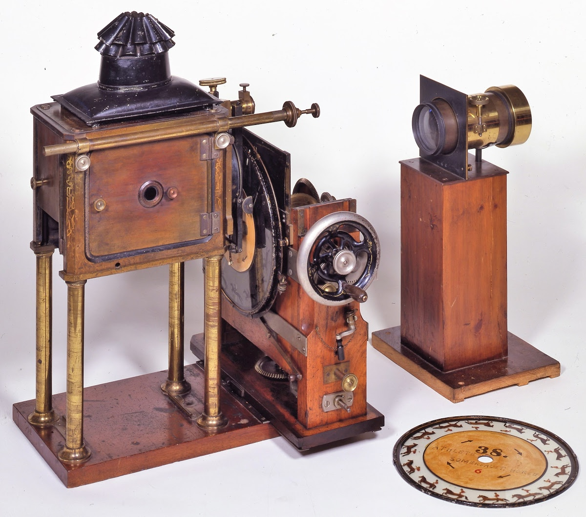
History of Zoopraxiscope
Eadweard Muybridge's Zoopraxiscope, invented in 1879, was the first movie projector, animating sequential images captured by cameras along a track.
Muybridge's invention used rotating glass discs to swiftly project stop-motion images, simulating motion. Initially, hand-painted silhouettes were employed, later replaced by outline drawings printed photographically onto the discs and then hand-colored.
Fig 1. Zoopraxiscope made by Eadweard Muybridge

Slide 6
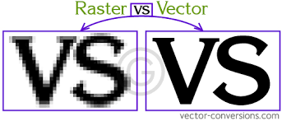
History of Bitmap Raster Images
Bitmap raster images, originating in the 1960s and 1970s, have been fundamental to digital imaging since. They gained widespread use with the advent of personal computers in the late 1970s and early 1980s.
Various file formats such as BMP, GIF, JPEG, and PNG emerged to cater to different needs in digital imaging. With advancements in technology, bitmap images have seen improvements in resolution and color depth.
Fig 2. Example of Vector Image and Raster Image

Slide 7
Flow Chart for Zoopraxiscope
Recreation of Zoopraxiscope
Gather Material
Construct the Frame
Prepare Images
Attach Images to the Frame
Mount the Disk or Wheel
Set up the Light Source
Test the Zoopraxiscope
Fig 3. Flow Diagram of Zoopraxiscope

Slide 8
Flow Chart for Zoopraxiscope
Recreation of Zoopraxiscope
Initialize Libraries
Create Canvas
Define Slideshow
Loop through Images
Process Each Image
End of Slideshow
Fig 4. Flow Diagram of Zoopraxiscope

Slide 9
Flow Chart for Bitmap Raster Image
Recreation of Bitmap Raster Image
Define Image Properties
Create Blank Image
Access Pixels
Loop Through Pixels
Apply Checkerboard Pattern
Display Image
Fig 5. Flow Diagram of Bitmap Raster Image

Slide 10

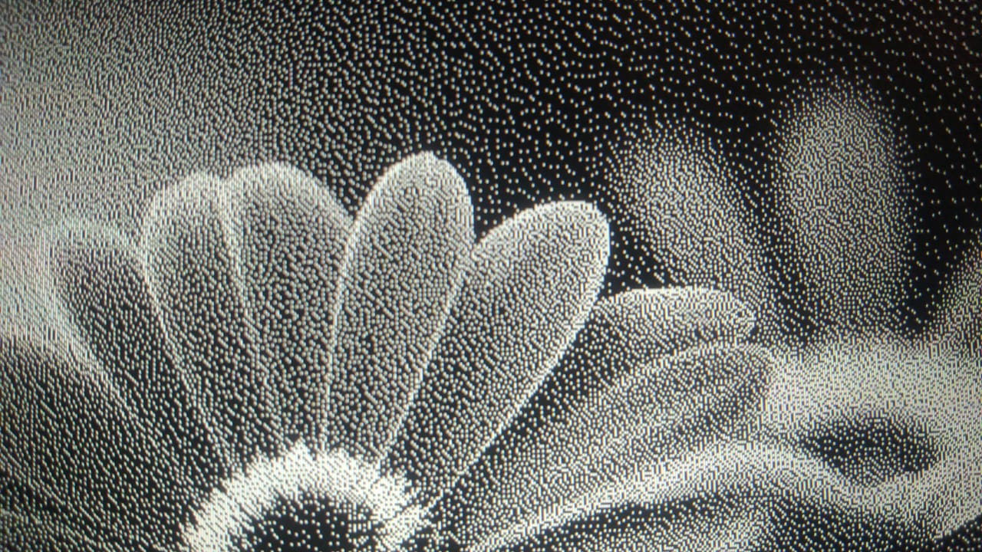
Implementation of Bitmap Raster Image
Fig 6. Performed on Python Compiler
Fig 7. Performed on Photoshop

Slide 11
Components Required
Table 1: Table of Components
Sr. No | Components Required | Cost In Rupees
1 | Motor (100 RPM) | 100/-
2 | Potentiometer (1M) | 50/-
3 | Transparent Sheets | 30/-
4 | Cardboard Box | 20/-

Slide 12
Conclusion
Thorough research into Zoopraxiscope and bitmap raster images provided valuable insights into their construction and operation.
Utilizing modern design software and manufacturing tools, updated versions of both were prototyped.
Historical essence of Zoopraxiscope and bitmap raster images was maintained while enhancing functionality and usability.
The project ensures the continued relevance and fascination of these iconic inventions in today's digital age.

Slide 13
References
[1] S. Jones and A. Smith, "Reviving Historical Animation Devices: A Study on the Recreation of Zoopraxiscope in Modern Contexts," Journal of Digital Arts and Culture, vol. 15, no. 2, pp. 45-62, 2020.
[2] L. Chen and Q. Wang, "Enhancing Bitmap Raster Image Reconstruction with Advanced Techniques," International Journal of Computer Graphics, vol. 7, no. 4, pp. 112-125, 2019.
[3] R. Kumar and S. Gupta, "Modernizing Traditional Animation Techniques: A Study on the Recreation of Bitmap Raster Images," Journal of Visual Arts and Design, vol. 25, no. 3, pp. 78-91, 2018.
[4] N. Patel and M. Shah, "Innovative Methods for Replicating Historical Animation Devices: A Case Study on Zoopraxiscope," International Journal of Digital Media Studies, vol. 12, no. 1, pp. 33-48, 2017.

Slide 14
Thank You!!

